Slide 1


Dataverse is more than just a database
Wed, Sep 21, 2022 | 11 AM - Noon
James Oleinik
Dir. Product Management Dataverse, Microsoft
James.Oleinik.@microsoft.com
Julie Koesmarno
Principal Product Mgr Dataverse, Microsoft
Julie.Koesmarno@microsoft.com
Guest speaker: Huy Tran
Power Program Manager Exxon Mobil
Notes:
My name is James Oleinik and I'm so excited to be here and talk to you all today
about your friend in the Power Platform that maybe you didn't know you had.

Slide 2

What is Dataverse?
Notes:
Let’s start off with my favorite question of all. What is Dataverse?
And while its integral to many of the capabilities that have been talked about and demoed across the Power Platform converenfe over the past 2 days.
It actually can something different to every organization depending on where they are coming from.

Slide 3
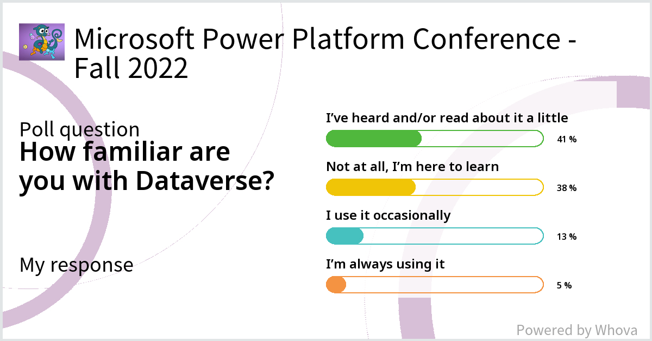
Poll results
Notes:
Humbled by the opportunity to speak to a lot of customers, partners, developers – across 1P & 3P – over the past 3 months.
And we always started with the same question. Which is both my favorite and my least favorite question to ask and question to answer.

Slide 4
Community Questions on Dataverse
Dataverse is a Common Data Service for all power platform tools. LOL
an excel spreadsheet with way more capabilities
How do you explain Dataverse to someone brand new to the Power Platform?
SQL on steroids
\"wrapper on SQL server....use that so your app using more than 4,000 rows won't crash\"
It is a relational database built inside the Power Platform and can be used with premium license. It's the new SharePoint
Notes:
And what is so interesting is when we asked that same question to customers that are betting BIG on Power Platofrm – enterprise why AND THEY GET IT

Slide 5
but its not that simple!
is more than a database

Slide 6
Feedback from Customers
Schema requirements (Relational vs No-SQL like MongoDB) / Estimated cost of implementation & ROI
For new things we try to use Dataverse… Citizen devs usually use SharePoint since they are familiar…
How do your makers/architects decide on a data source when building a new solution?
IMO – [Dataverse] is a poor choice compared to SQL for the sort of solutions I need to build. I need things like CTES, Sprocs, transactions, perf feedback and tuning
We help understanding use cases but there’s a decision matrix for the full technology stack..
Notes:
BUT then when you ask them a broader question.
How does your org decide?
How do your IT Pro-dev’s decide?
How do you makers decide?

Slide 7
Data is key,
but it’s just a piece…
We help understanding use cases but there’s a decision matrix for the full technology stack..
Notes:
BUT then when you ask them a broader question.
How does your org decide?
How do your IT Pro-dev’s decide?
How do you makers decide?

Slide 8





The good news
Beautiful, easy to build/use apps for your business
The Power Platform provides low code development tools which enable you to solve many challenges of today’s workforce, for accelerated low-code solution development.
Externally facing portals for selectively surfacing data on pages
Easy to deploy bot framework for websites and channels
Automation (both digital and robotic)
Integrated insights and analytics
Over 800 out-of-box data connectors
App + Data Lifecycle Management

Slide 9





The bad news
We must protect sensitive data or we may be open to litigation. Everyone should snap to a strong security model.
Even with the Power Platform, there are data stewardship problems to solve for, which are related to the many apps, automations, bots, websites and dashboards, which are now critical to business continuity.
We must provide a coherent method of data connectivity across the many systems we depend upon today.
We must insist on data integrity, and ensure business policies are respected across all data-driven workstreams (for many Regions, Users, Teams, and Business Units).
We must support our workforce with enablers (such as automations, artificial intelligence, and machine learning), to reduce error and time needed to deliver the best customer experiences.
We must enable our business users, analysts, and devs to easily visualize data insights in order to make the decisions that will result in the best outcomes and highest ROI.
Notes:
I have to protect it, I have to be careful around the data I store and who I given access to it
Coherent method of data connectivity, but does every have the time and resource to build out an API strategy across
If you’re dealing with shared, business critical data then it needs to be validated AT ALL points of entry, not just in your app, but Automate, Bots Pagers
Insights
Not business process without reports

Slide 10
Dataverse steps in to solve those challenges
Dataverse
Business Logic
A data platform to structure data, events, logic, and insights in a secure and compliant manner
Intelligence + Analytics
Integration
App + Data Lifecycle
Data Storage
Security + Governance

Slide 11








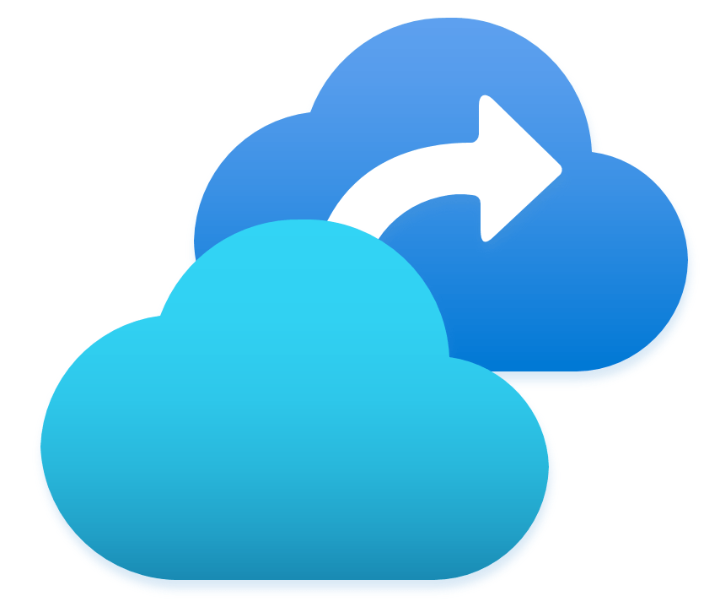








Dataverse steps in to solve those challenges
Dataverse
A fully managed cloud data platform to structure data, events, logic, and insights in a secure and compliant manner
Azure Batch
Functions
Azure Load Balancer
VMSS
Intelligence + Analytics
Azure Cognitive Services
Azure ML
Power BI Embedded
Azure Synapse
Azure Data Factory
Event Hub
Event Grid
Service Bus
Fluid Relay
Azure Resource Provider
Archive Storage
Azure Backup
Azure DevOps
Azure SQL
CosmosDB
Azure Storage
Azure Datalake
Azure Search
Azure Active Directory
Key Vault
Microsoft Purview
Private Link

Slide 12
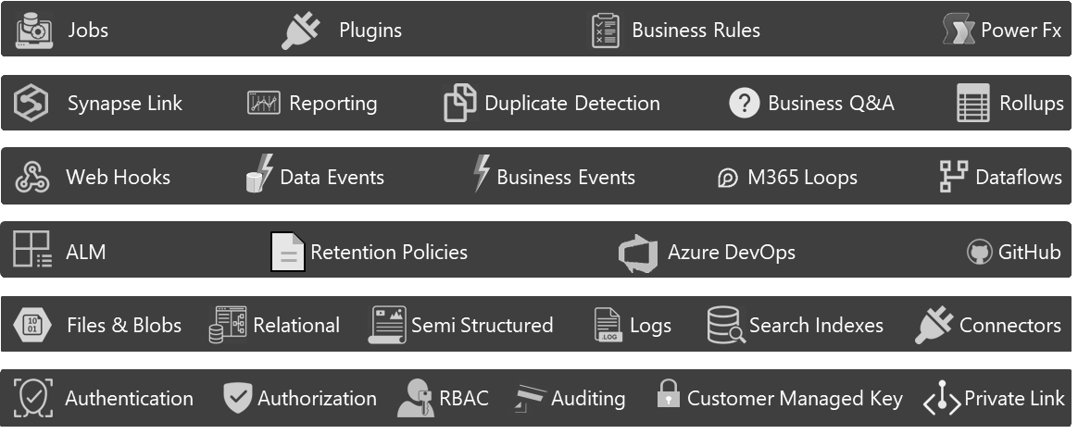
Natively integrated
Dataverse
A fully managed low code cloud data platform to easily structure data, events, logic, and insights to enable interconnected applications and processes in a secure and compliant manner
Azure Batch
Functions
Azure Load Balancer
VMSS
Azure Cognitive Services
Azure ML
Power BI Embedded
Azure Synapse
Azure Data Factory
Event Hub
Event Grid
Service Bus
Fluid Relay
Azure Resource Provider
Archive Storage
Azure Backup
Azure DevOps
Azure SQL
CosmosDB
Azure Storage
Azure Datalake
Azure Search
Azure Active Directory
Key Vault
Microsoft Purview
Private Link

Slide 13
Why Dataverse…
For your data?
For your solution?
For your enterprise?
Approachable data activation for your business problem
Accelerated delivery with Power Platform
Built for enterprise, Built to last
What did @MsSQLgirl not have to build we she converted to Dataverse?
How did Huy deliver acceleration & value through Power Platform?
How far can it scale and what next?
Easy as Excel, connected to your full enterprise data
Logic & data access for multi-team, multi-persona
Native integration into each Power Platform product
That pays off the more you scale: Time, TCO
Battle-tested enterprise scale & compliance
Integrated to enterprise Data & analytics story (tease Sabin session)
Notes:
These are three critical areas that we are investing int that are going to help address some of those problems
Easy as Excel, connected to your full enterprise data
Facilitated data access and business logic for any enterprise matrix
Native data integration into each Power Platform product
Battle-tested enterprise scale & compliance

Slide 14
Approachable
data
Notes:
And with that I’m very excited to introduce Julie who is one of the newest members of the Dataverse product teams who recently joined us from the SQL team at Microsoft.
And share is going to walk your through some of her learnings since joining the team and highlight some investments we’ve been working on to making Dataverse as approachable as Excel.

Slide 15
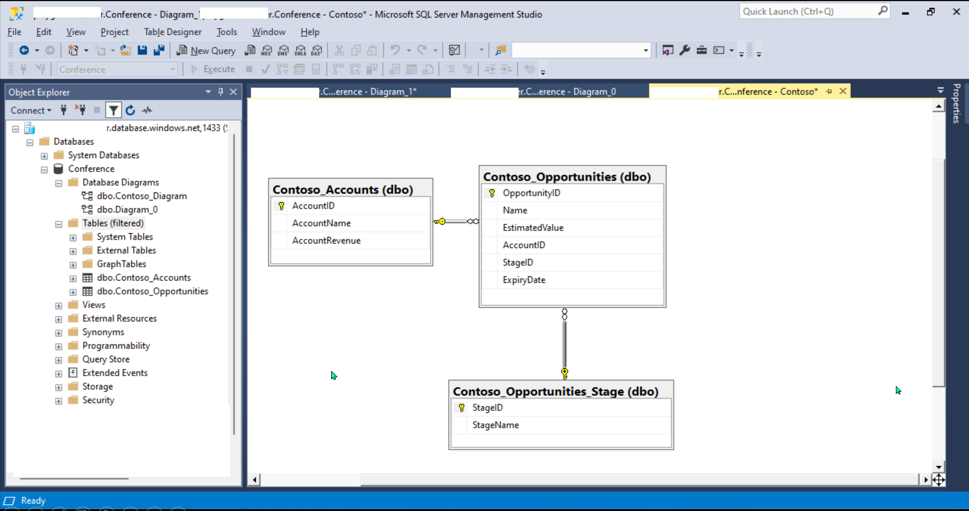
ERD with SSMS when creating tables in SQL Server

Slide 16
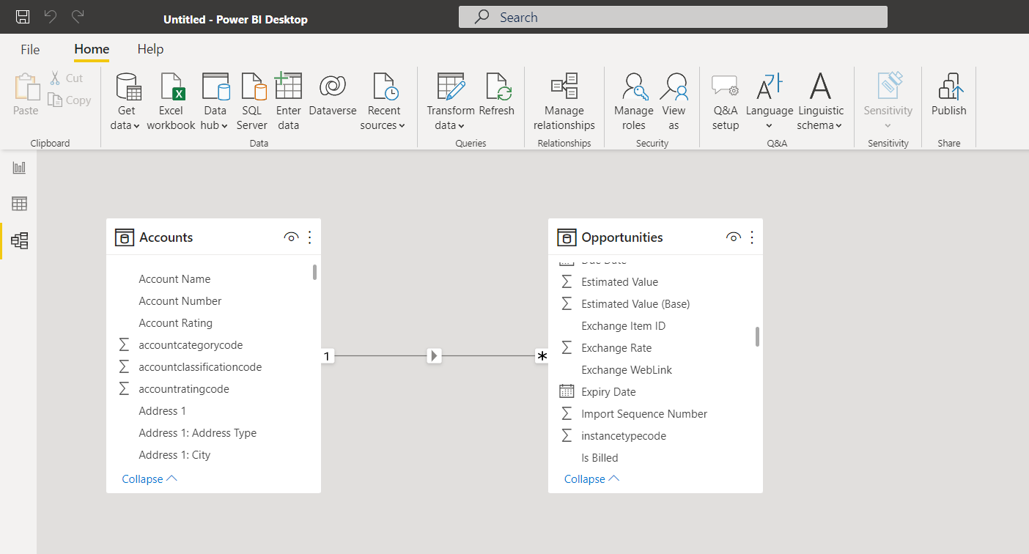
ERD with Power BI connecting to Dataverse

Slide 17








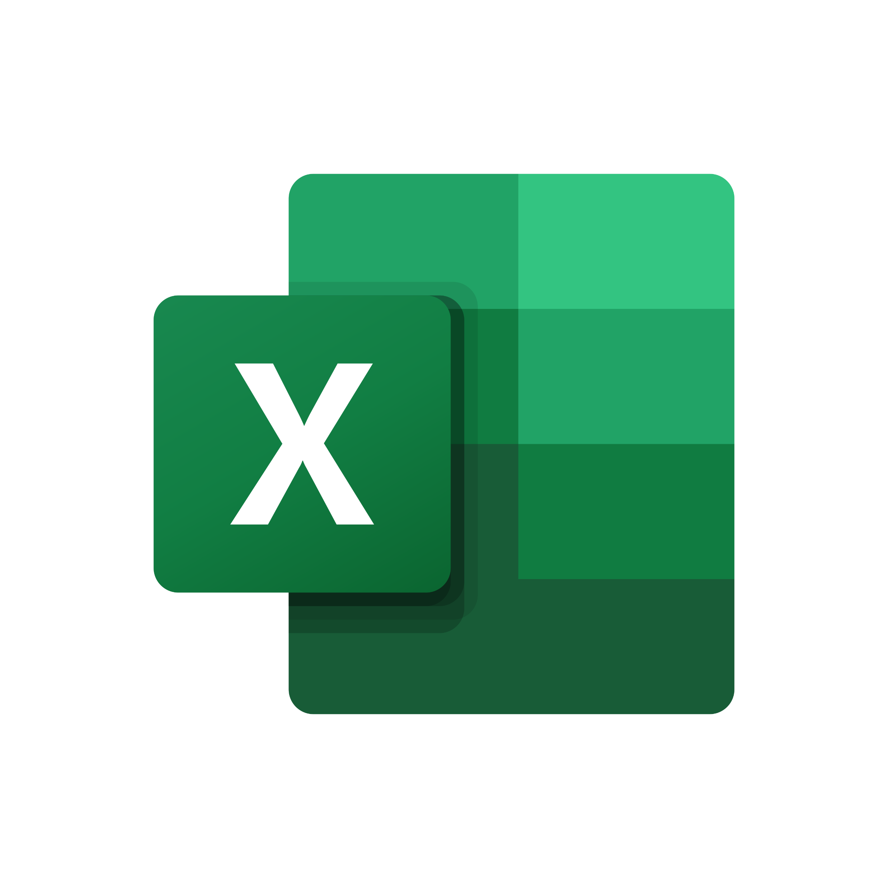

Hero use-case
Julie of 2 years ago
Julie of today
Front End
App
Report
Automation
Business Layer
Reporting & Analytics
Business Layer
Data
Transaction data
Files
Data Lake
Notes:
New - what do you not need to build on Sql/Azure (it comes for free)
Polyglot Storage layer -> different shapes of data (file attachment, transaction data, images, etc)
Secure data access layer
Business process data/BL modeling layer
Fully integrated into API/App/Automation/Analytics
What Julie I had to build to build a typical application? X, y, z
Here’s what came out of the box? X, y, z
~ 3-6 months. 2 devs
~ 2 – 3 weeks. 1 person

Slide 18
Hero use-case
Julie of 2 years ago
Julie of today
`
Front End
Front End
Automation
Business Layer
Reporting & Analytics
Transaction data
Files
Data Lake

Slide 19
Hero use-case
Julie of today
Julie of today
From Months to 1 day
From depending on a few devs to just me
From managing different code complexity to delivering value NOW.
App
Report
Automation
Business Layer
Data

Slide 20




Easy as Excel!
Get up to 3 Personal Environments to get started in your Dataverse Data Workspace
Quickly and easily integrate existing data into Dataverse with Dataflows (aka Power Query)
Write your own formulas using the Power Fx Excel-like expression language
Leave the data where it is and leverage it from Dataverse using our new Virtual Table Wizard
aka.ms/ DeveloperPlan
aka.ms/ DataverseDataflows
aka.ms/ DVFormulaColumns
aka.ms/ VirtualTableProviders
https://aka.ms/Dataverse

Slide 21




Facilitated data access and business logic for any enterprise matrix
Value:
The How:
Role-based Security
Privilege
Explicit Sharing
Security Role
Ownership (User and/or Team)
Restrict & grant access to shared records across teams
Restrict & grant access to certain table columns & records
Business Unit
Sharing Rule
Record Segmentation by Business Units
Groups = Teams
Field Level Security
Hierarchy
Organization
https://aka.ms/DataverseSecurityConcepts
Notes:
Privilege - Definition of access permission for tables and records
Security role - Collection of privileges scoped to a role as they relate to record ownership, business unit or organization.
Business Unit – Define a security & record boundary. Used to define groups of users for record level security. Examples: Sales, LATAM, Engineers
Organization - Used to provide access across an entire Dataverse instance or organization
Sharing rule - Method of defining explicit sharing privileges to certain records.
Field Level Security - Method of restricting and granting access to certain table columns through column policies.
Hierarchy Option to drive security inheritance based on a hierarchical structure (manager or position).

Slide 22
Accelerating Delivery with Power Platform
Notes:
We’ve seen a simple two-table use highlighted some of the art of the possible
But how about a real enterprise use – case
I’d like to introduce Huy on Stage to talk through his journey and story at Exxon

Slide 23
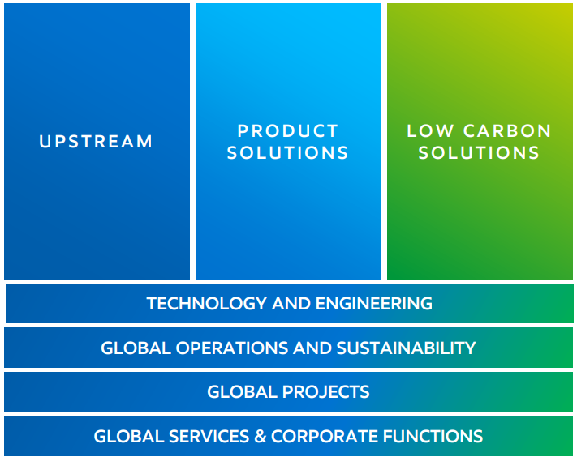
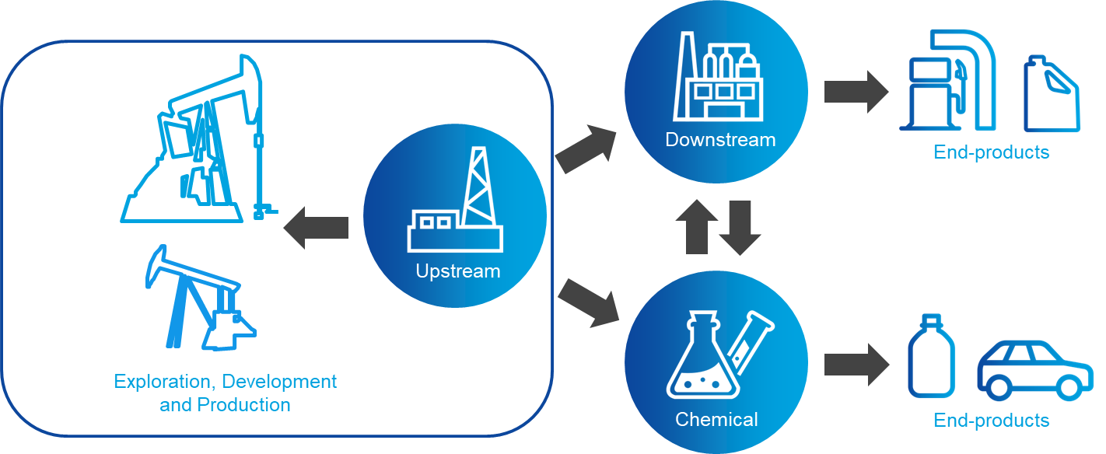




ExxonMobil

Slide 24
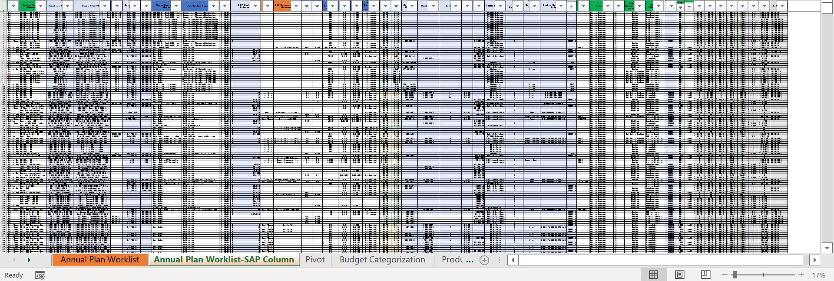
Annual Maintenance Plan
Risk-based Work Selection (RBWS) with zero-based budget development approach
Risk scenarios is essential part of AMP
Central playground with common repository with security, transparency and accountability
Pain Points

Slide 25
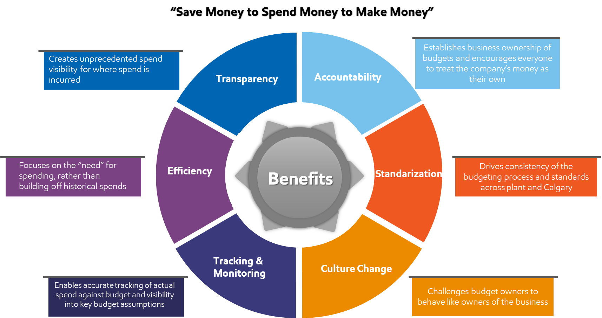
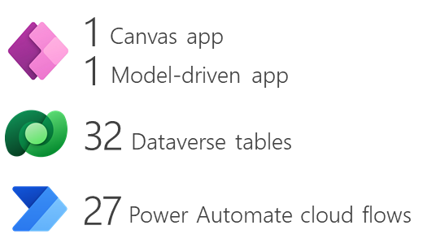
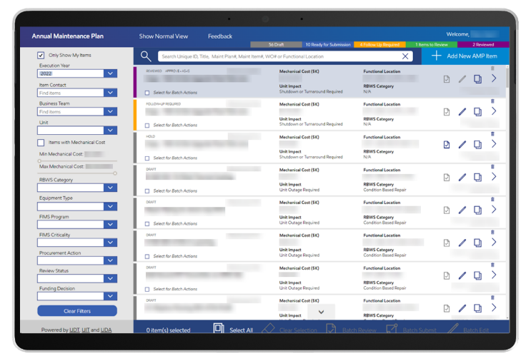
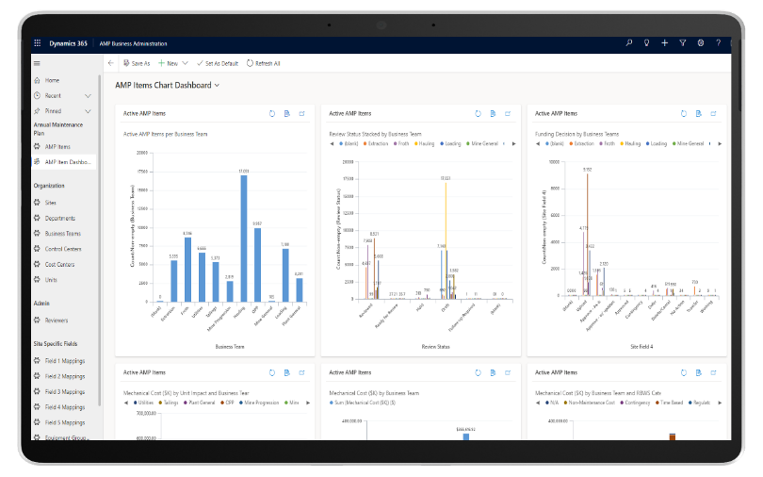
Digital AMP Demo Video

Slide 26
Annual Maintenance Plan Journey
Maintenance
“We need a digital solution by April.
This is not sustainable.”
Pro Dev
“We need minimum 9 months”
Huy
“Let’s try Power Platform!”
2020
Oct
Nov
Dec
Jan
2021
Security
Rapid Development
Available Building Blocks
Easy to Build
Throttling Limits
Delegation
Complex Forms
MSFT Support
Community
Digital AMP
Complete
Digital AMP
AMP Business Process Kickoff
Go live (150 users)
Feb
Mar
Apr
May
Jun

Slide 27











AMP Digital Solution High Level
AMP Dashboard
DATA
REPORT
Management
Business Teams
50K – 60K records / year
AMP Admin Portal
Kearl, Cold Lake
Heavy Oil
Azure Data Lake
AMP Admin
APPLICATION
Hebron
Azure Data Factory
Pipeline
Kepler
30K records / year
AMP App
AMP Users
Upstream Data Foundation
Notifications – Review Process
Calculation
AUTOMATION
AMP Automation Flows
SAP Write-back API
Future – timing TBD

Slide 28
AMP Digital Solution Going Enterprise
AMP Dashboard
DATA
REPORT
Management
Business Teams
50K – 60K records / year
AMP Admin Portal
Kearl, Cold Lake
Heavy Oil
Azure Data Lake
AMP Admin
APPLICATION
Hebron
Azure Data Factory
Pipeline
Kepler
30K records / year
AMP App
AMP Users
Upstream Data Foundation
More Upstream Sites
Notifications – Review Process
Product Solutions Manufacturing Sites
Calculation
AUTOMATION
70K+ records / year
AMP Automation Flows
SAP Write-back API
Future – timing TBD

Slide 29
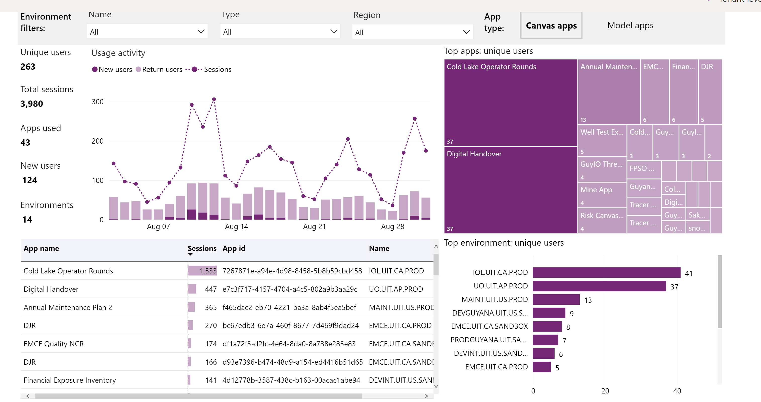
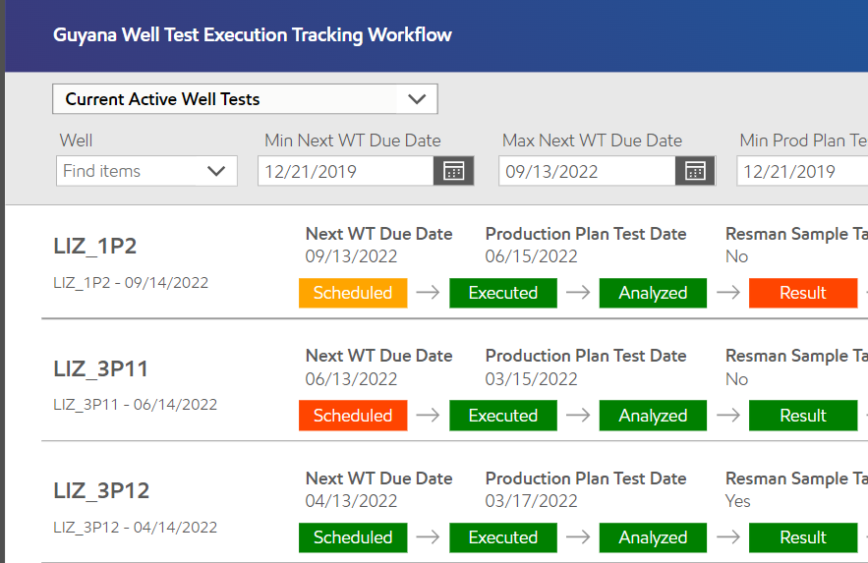

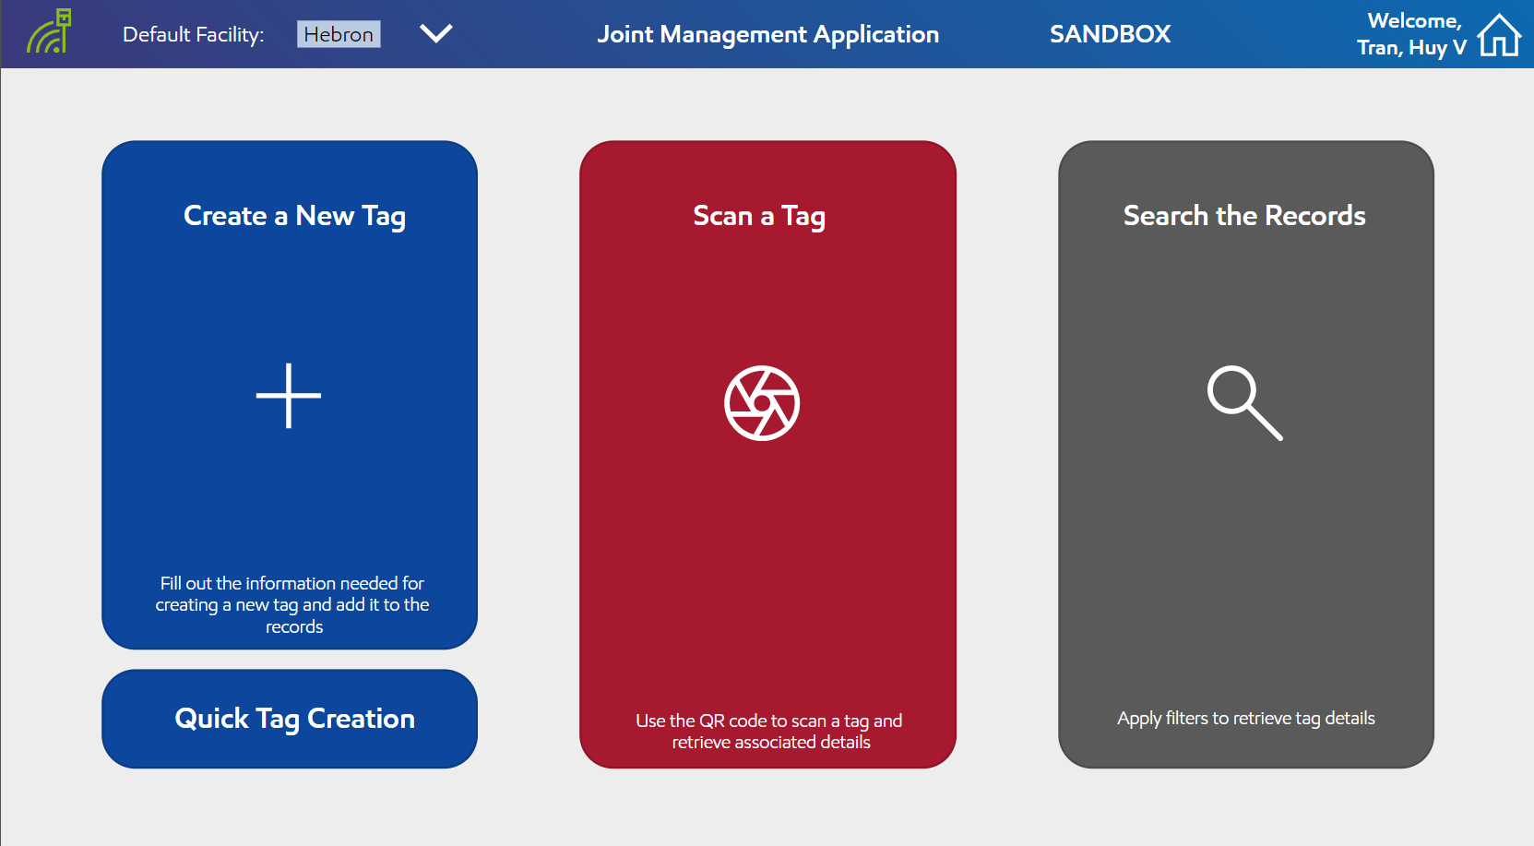
“It was just the beginning” since then…
Specialized Program in the Upstream to deliver high value digital solutions
2,000 additional Power Apps licenses consumed in the first 8 months of 2022 across ExxonMobil
Upstream Operations
Unconventional
Environment
Chemical
Projects
Product Solutions
ExxonMobil Upstream Operations
August 2022 Power Apps Usage
EM IT Power Platform COE

Slide 30
Advice from a veteran Power Platform advocate
BEFORE
AFTER
Development: 1+ Pro-dev 2 motivated makers
Time: 9 months 2w to concept, 3m to GA
New requirement: File a request Huy-tested, Business approved
VS
Notes:
How did make the leadership believe in AMP version 0? -> Get the makers on their behalf How has that conversation changed since? -> Talk to Huy

Slide 31
Built for enterprise, Built to last
Notes:
Humbled by the opportunity to speak to a lot of customers, partners, developers – across 1P & 3P – over the past 3 months.
And we always started with the same question.

Slide 32
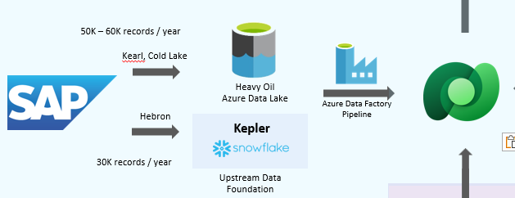
AMP’s Scale Journey
10+ spreadsheets / list
100+ tables
100+ co-users
Kearl
Hebron, Cold Lake
15 GB to-date
60K annual records
250 total users
3 GB to-date
30K annual records
400 total users
Notes:
What is support awesom
Kearl - Unify link
Hebron - Unify link

Slide 33
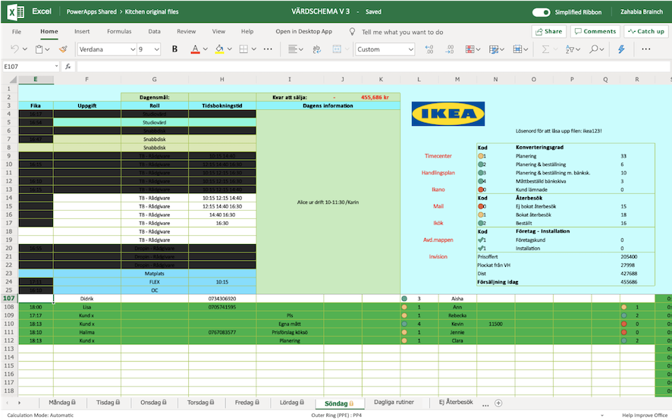
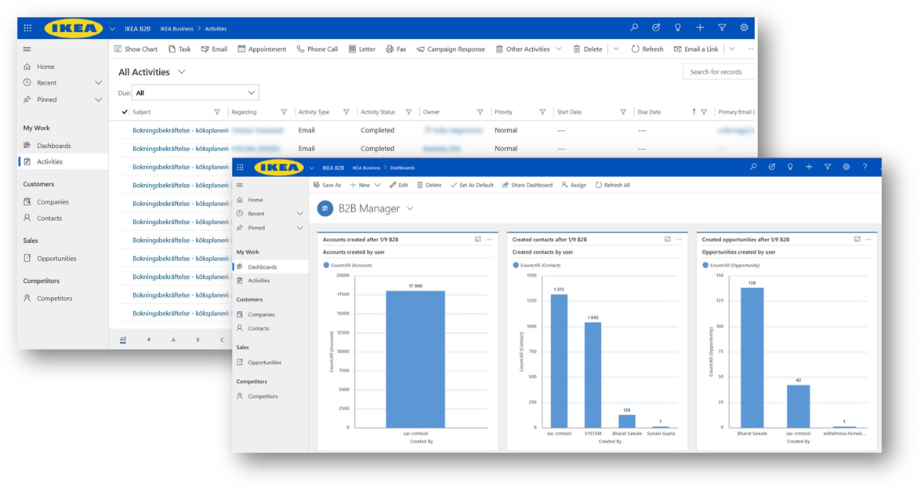

Dataverse unlocks battle-tested enterprise scale
“IKEA sees me” when working through the process of building a new kitchen
211,000 employees
433
stores
50
e-commerce markets
https://aka.ms/powerikea
Notes:
Dataverse scales so you don’t need to
Dataverse serves as the central repository building PowerApps for B2B, C2C scenarios
(Royal Enfield stability learnings.pptx)

Slide 34

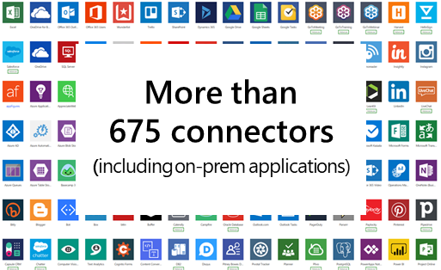




Dataverse unlocks battle-tested enterprise scale, built on Azure
Storage
Dataverse
Table types
Files: Unlimited scale
Audit Logs: Unlimited scale
Else: 100TB / 2 billion rows
Data model for objects, files and images
Data model
for emails, appointments,
etc.
in timeline
Compute
Virtual Tables
Standard Tables
Activities Tables
API: 5M requests per hour*
Async: 1M jobs per hour*
*Approximate peak from current customers & subject to service protection & licensing limits
Notes:
4.5 – 5 Million (peak) Web API request per hour.
~50K+ SQL queries executed per second.
~400 rps on Async at peak load (1.2-1.4M jobs per hour).

Slide 35
With even more scale improvements coming soon…
Dataverse
Table types
Archival Policies
Data model for objects, files and images
Data model
for emails, appointments,
etc.
in timeline
Speed up your data load
Process and read data for AI/BI
Virtual Tables
Standard Tables
Activities Tables
“Elastic Tables”
“Analytical Tables”
New upcoming Dataverse capability

Slide 36
What’s next?
Approachable Data
Accelerated Delivery
Built for Enterprise
Dataverse Workspace* with easy-as-Excel table experiences
Power Fx beyond just formula columns*
3-Click wizard-like creation of Virtual Tables* with more data sources (SQL, Excel)
Connector improvements with more actions in Power Automate and a single comprehensive connector for Dataverse
Simplified security model and configuration interface
Dynamic AAD Security Groups facilitating Team/Business Unit member synchronization
Performance and storage improvements for Dataflows
Every Power Pages solution fully backed by Dataverse*
New Power Automate templates to expedite cloud automations
Simplified Microsoft 365 integration & setup (Email, Meetings, Appointments) powering new Collaboration app controls
Archival policies for unlimited storage
Extended pro-dev scalability with solution improvements, Bulk Operation APIs, & Elastic Tables
Optimizations for Power BI and Azure Synapse Link integrations
We heard your feedback on Risk & Compliance! --Lockbox --CMK --Network isolation --Managed Identity
*Now in Public Preview!
Notes:
1. Power FX Maker will be able to define server-side business rules inside DV table such as setting up field validations, field defaults, setting up visibility etc.
2. Formula Columns replace Calc fields
3. Simplified mailbox set up for email and meeting track/sync with less steps and proactive validations (from 3 steps involving Global Admin to 1 step by user)

Slide 37



Do more with Your Dataverse Data
Tomorrow, 8:00 am
Milinda Vitharana
Sabin Nair
Excel & Power BI
Synapse Link
Easily access in Excel
Power BI at your fingertips
Accessible to all makers in your organization
Share reports with your team
Large amounts of data
Copied to your own Azure Data lake – near real time
Enterprise grade Azure data tools + Power BI
Configured in a few clicks
Specialist tools for Power users & Data engineers

Slide 38
Call to action
Get up to 3 Personal Environments to get started in your Dataverse Data Workspace
Quickly and easily integrate existing data into Dataverse with Dataflows (aka Power Query)
Write your own formulas using the Power Fx Excel-like expression language
Leave the data where it is and leverage it from Dataverse using our new Virtual Table Wizard
aka.ms/ DeveloperPlan
aka.ms/ DataverseDataflows
aka.ms/ DVFormulaColumns
aka.ms/ VirtualTableProviders
https://aka.ms/Dataverse

Slide 39
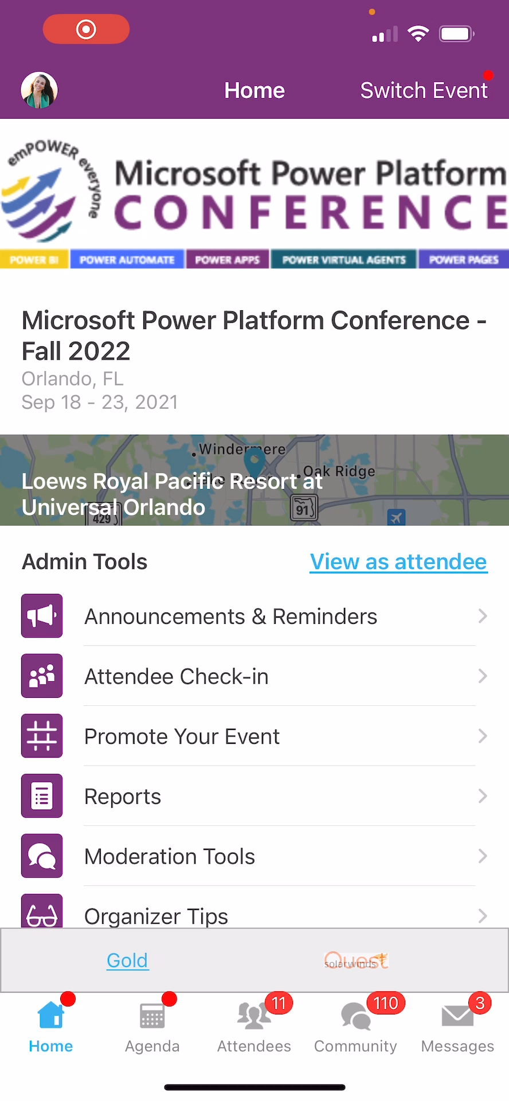
Session Feedback Surveys
In the pursuit of making next year’s Microsoft Power Platform Conference even better, we really want to hear your feedback about this session.
Here’s How -
Simply go to the Whova App on your smartphone
Go to the Microsoft Power Platform Conference event
Scroll down on the homepage to ‘Additional Resources’ and click ‘Surveys’.
Click ‘Session Feedback’.
Scroll down to click on this session title.
Complete the session feedback survey.
Finally, click ‘Submit’

Slide 40


Get for Microsoft Power Platform
Conference - Fall 2022

Slide 41




Upskilling for Career Switchers
POWER BI
POWER AUTOMATE
POWER APPS
POWER VIRTUAL AGENTS
POWER PAGES
A brand-new upskilling program for people from non-technical backgrounds, to enable them to get better career opportunities.
Through guided curriculum, self-paced learnings, instructor-led training, and hands-on exercises, participants will learn new skills while being supported by the Power Platform community and Microsoft product teams.
aka.ms/MSPowerUp

Slide 42
JOIN THE COMMUNITY
POWER BI
POWER AUTOMATE
POWER APPS
POWER VIRTUAL AGENTS
POWER PAGES
Discover the difference being part of the Microsoft Power Platform Community can make for you. With the latest News & Announcements, Forums, Microsoft-empowered User Groups, events, and more, you’ll find out why we believe in the power of community. Whether you’re a super user or just getting started, discover why we believe #CommunityRocks!
aka.ms/JointheCommunity

Slide 43
Microsoft Azure + AI Conference Azure Data Conference DEVintersection Conference Microsoft 365 Conference

